Slide 1
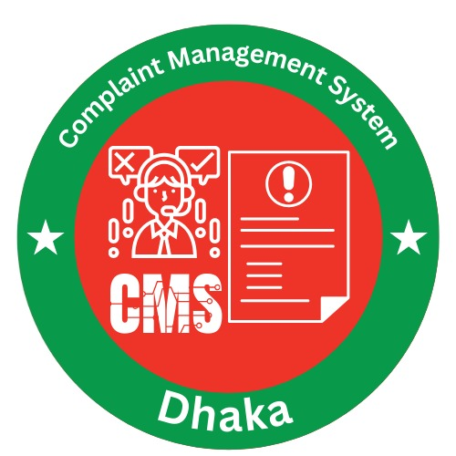
📊 Presentation: Complaint Management System

Slide 2



Meet The Team
Faruk Ahamed
Kailas Chakma
Kazi Afnan Alam
242-35-760
242-35-730
242-35-179

Slide 3

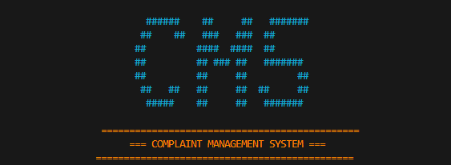
Introduction
Our Complaint Management System is a digital solution designed to manage and resolve complaints efficiently. It creates a seamless connection between citizens, employee, and administration, ensuring transparency, effective tracking, and clear accountability throughout the complaint resolution process.

Slide 4
System Roles
👤 User
👨‍💼 Employee
👑 Admin
Register/Login
View assigned complaints
Approve complaints
Submit complaint
Update complaint status
Assign staff to complaint types
Track complaint status
Contract with user
Add/Delete employee
View all complaints & users

Slide 5







Key Features
User Registration & Login
Complaint Submission
Anonymous Complaint
(Electricity, Water, Gas, etc.)
Tracking & Status Updates
Admin Approval System
Employee Assignment & Management
Data Persistence
(via text files)

Slide 6
Objectives
Centralised System
Citizen Empowerment
Provide a single platform for handling all complaints.
Allow citizens to register and track their complaints easily.
Admin Control
Simplified Resolution
Enable administrators to manage staff and approvals effectively.
Streamline employee assignments and complaint resolution.

Slide 7
Technical Details
Language: C (ANSI C)
Structs (User, Complaint, StaffEntry)
Data Storage: Text files (users.txt, complaints.txt, staff.txt)
File I/O (load/save functions)
Role-based dashboards (User, Staff, Admin)

Slide 8
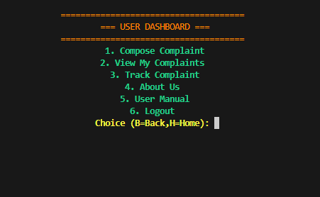
User Dashboard
1
Register Complaint
2
Track Complaint
3
View Status Updates
4
Logout

Slide 9
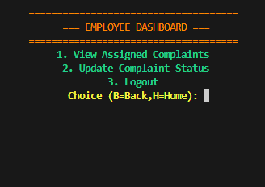
Employee Dashboard
1
View Assigned Complaints
2
Update Complaint Status
(In Progress / Resolved)
3
Logout

Slide 10
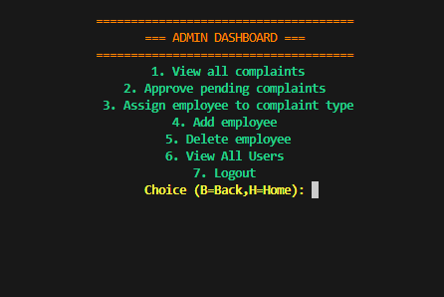
Admin Dashboard
1
View All Complaints
2
Approve Pending Complaints
3
View All Users
4
Assign Employee
5
Add Employee
6
Delete Employee
7
Logout

Slide 11
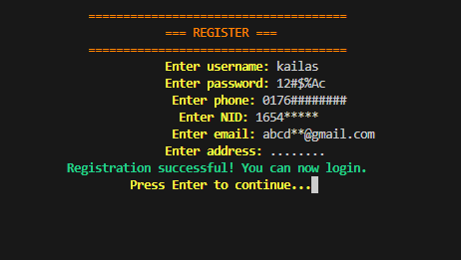
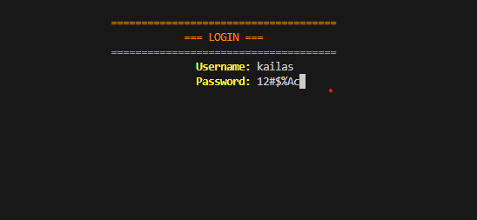
User Manual
1. Login/Register
Enter username & password to access the system.

Slide 12
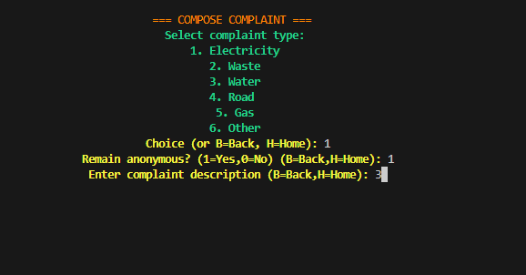
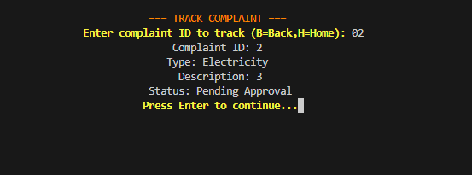
User Manual
2. Compose & Track Complaint
Use your unique complaint ID to monitor its progress.

Slide 13
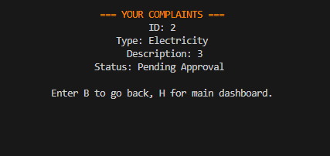
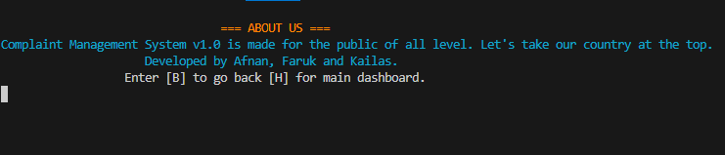
User Manual
3. Submit Complaint
4. About Us
Choose a category and provide detailed information.
To know about the developer

Slide 14





Benefits
Efficiency
Transparency
Scalability
Digital complaint handling streamlines processes.
Every complaint is tracked for clear visibility.
Supports multiple users and staff members.
User-Friendly
Accountability
Intuitive menu-driven interface for ease of use.
Admin and Employee monitoring ensures responsibility.

Slide 15
Scope of the System
Broad Applicability
Multi-User Support
Useful for organizations, municipalities, and service providers.
Capable of handling multiple users & staff simultaneously.
Scalability
Future Foundation
Designed to be scalable for large complaint databases.
Provides a strong basis for future web/mobile app development.

Slide 16


Future Enhancements
Database Integration
GUI Support
Transition to MySQL/SQLite for robust data management.
Implement a graphical user interface for enhanced usability.
Mobile/Web Application
Notifications & Reports
Develop dedicated applications for broader accessibility.
Add features for automated notifications and comprehensive reporting.

Slide 17
Conclusion
The Complaint Management System offers a reliable and transparent solution for handling complaints. It provides a strong foundation for future upgrades and effectively brings users, staff, and admins together under one cohesive digital platform.

